Slide 1

DRESS CODE WORSHIP NIGHT 2022 SEASON OF GLORY.
Theme colors ;
Royal Purple for gents.
Lavender for ladies.

Slide 2
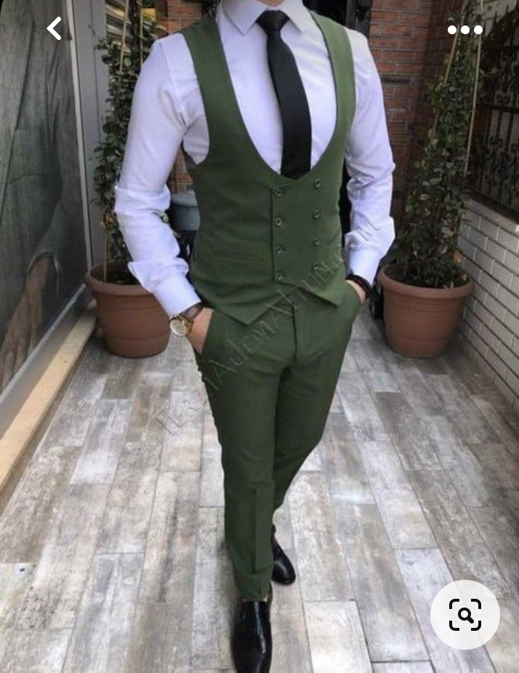
CHOIR AND INSTRUMENTALISTS GENTS.
Purple Trouser
Purple Half – coat
White long – sleeved shirt
Tie;
a) Choir gents: purple flowered tie
b) Instrumentalists gents: purple polka – dot tie
Price: 2100

Slide 3
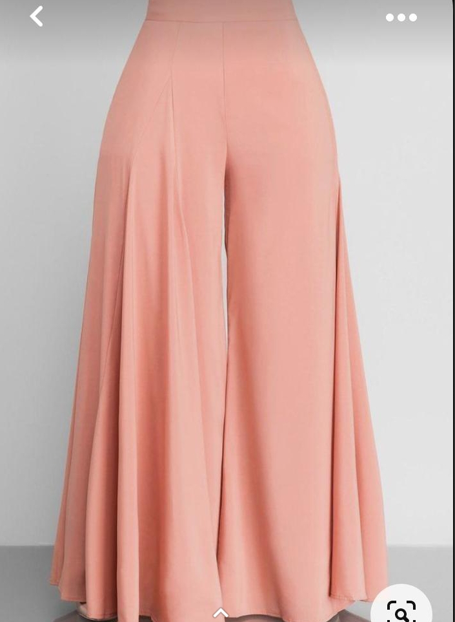
CHOIR PLUS INSTRUMENTALIST LADIES.
Purple palazzo
White turtle neck.
PRICE: 2000

Slide 4
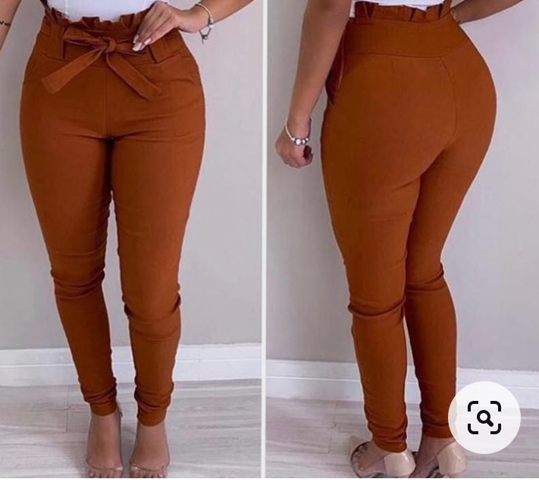
CREATIVE LADIES.
Purple trouser.
Black turtle neck.
PRICE: 1900

Slide 5
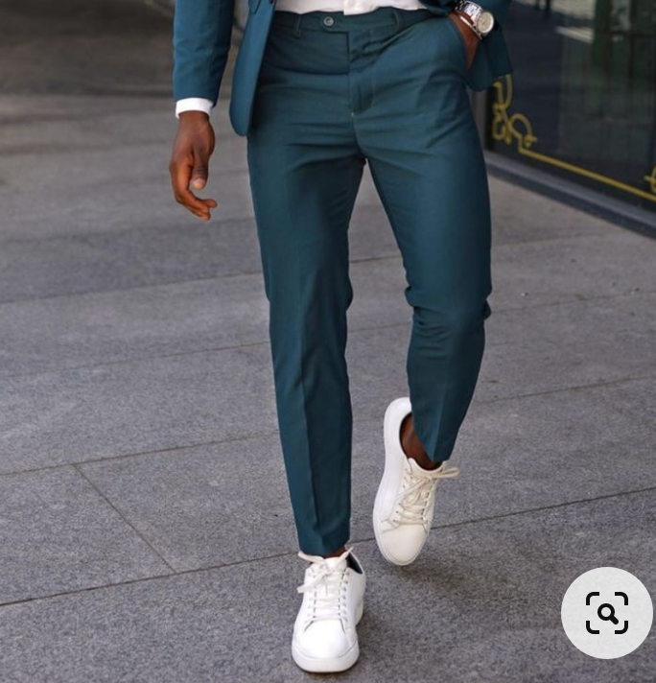
CREATIVE GENTS.
Purple trouser.
Black turtle neck.
PRICE: 1900

Slide 6
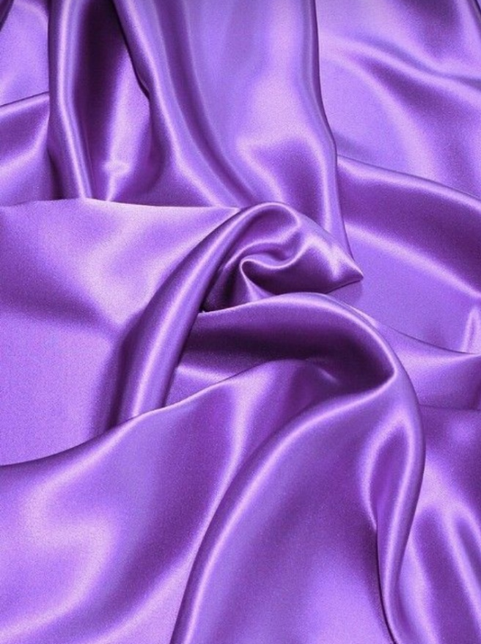
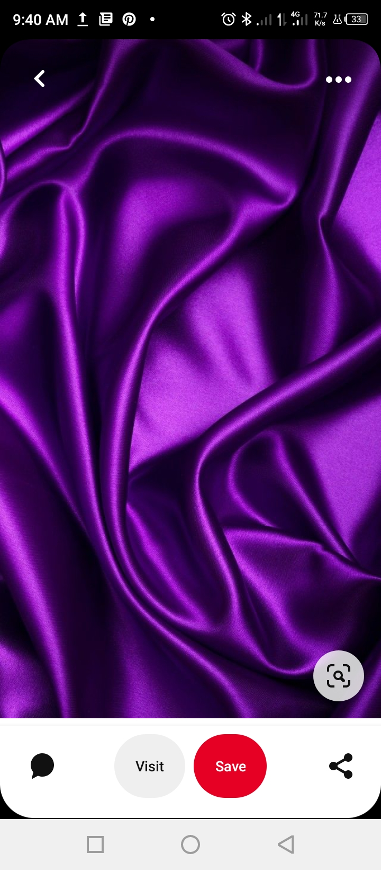
Theme colors:
Lavender Royal Purple

Slide 7
MODE OF PAYMENT
Send money
to
0795771210 – MARTHA WAWERU
Then FORWARD your NAME and MPESA MESSAGE to 0723050714 - Daniel Lochongo

Slide 8
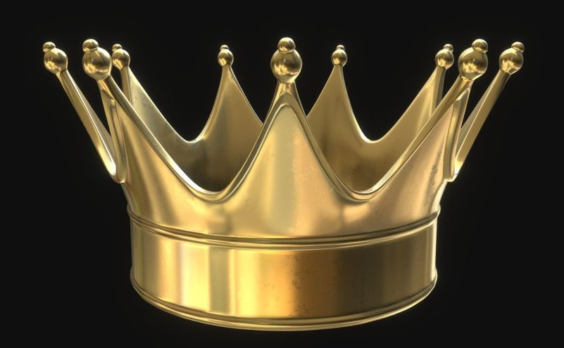
For any enquiries kindly contact;
Esther Waweru – 0794370676
Daniel Lochongo – 0723050714

